Slide 1
Streaming Data Engineering A Tale of Three Streams
Emanuele Della Valle
prof @ Politecnico di Milano
founder @ Quantia Consulting
founder & CRO @ motus ml

Slide 2
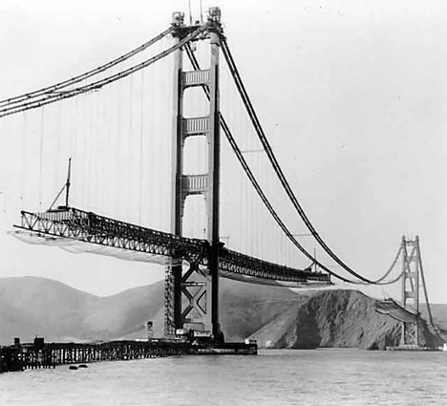

1st premises: continuity matters

Slide 3
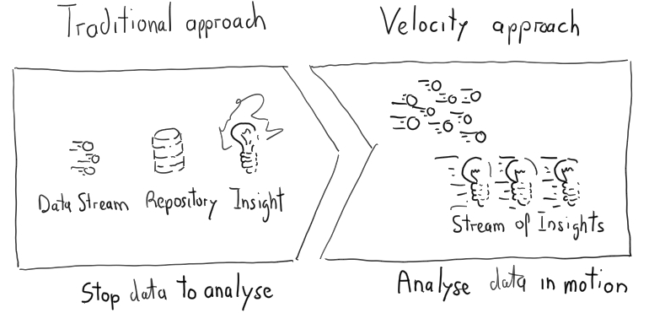
1st premises: continuity matters

Slide 4
1st premises: continuity matters

Slide 5
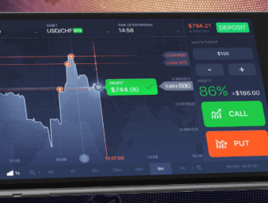
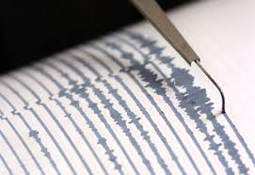
1st premises: continuity matters

Slide 6
Stream: a useful metaphor to explore the solution space

Slide 7
Streams take many forms …

Slide 8

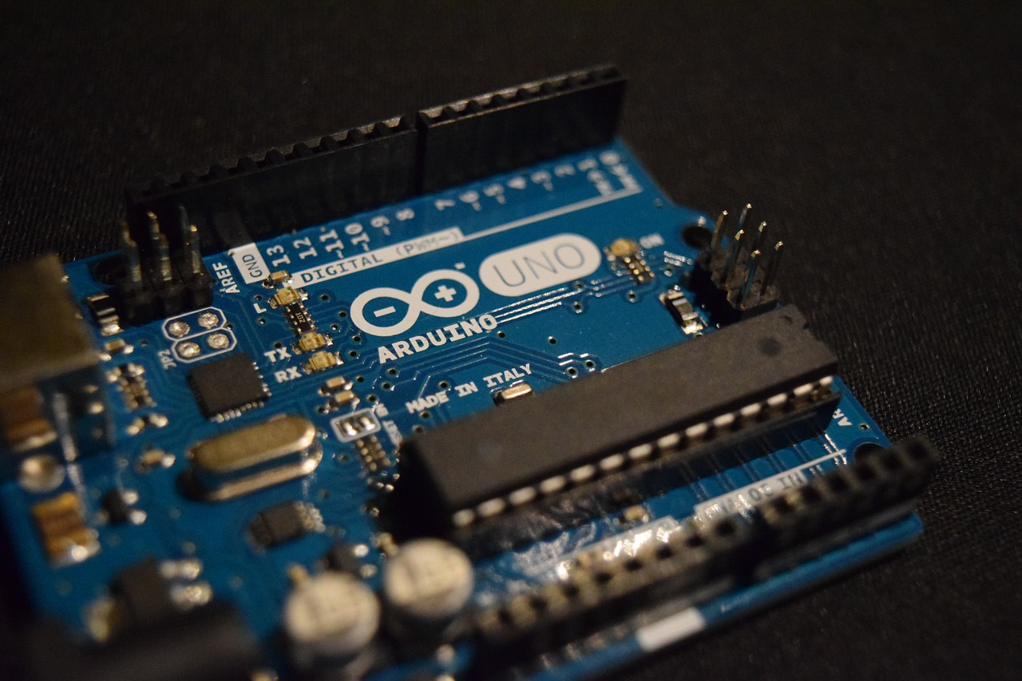
Myriads of tiny flows that you can collect
e.g., from physical or software sensors
Image by Daan Lenaerts from Pixabay

Slide 9
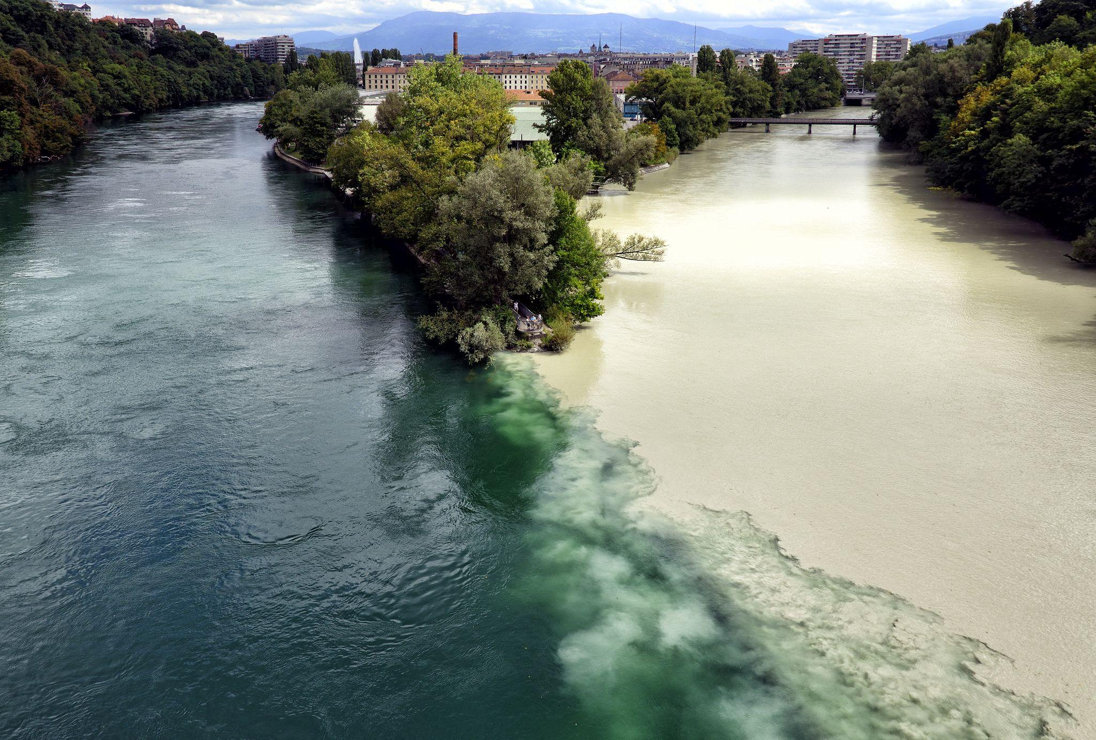
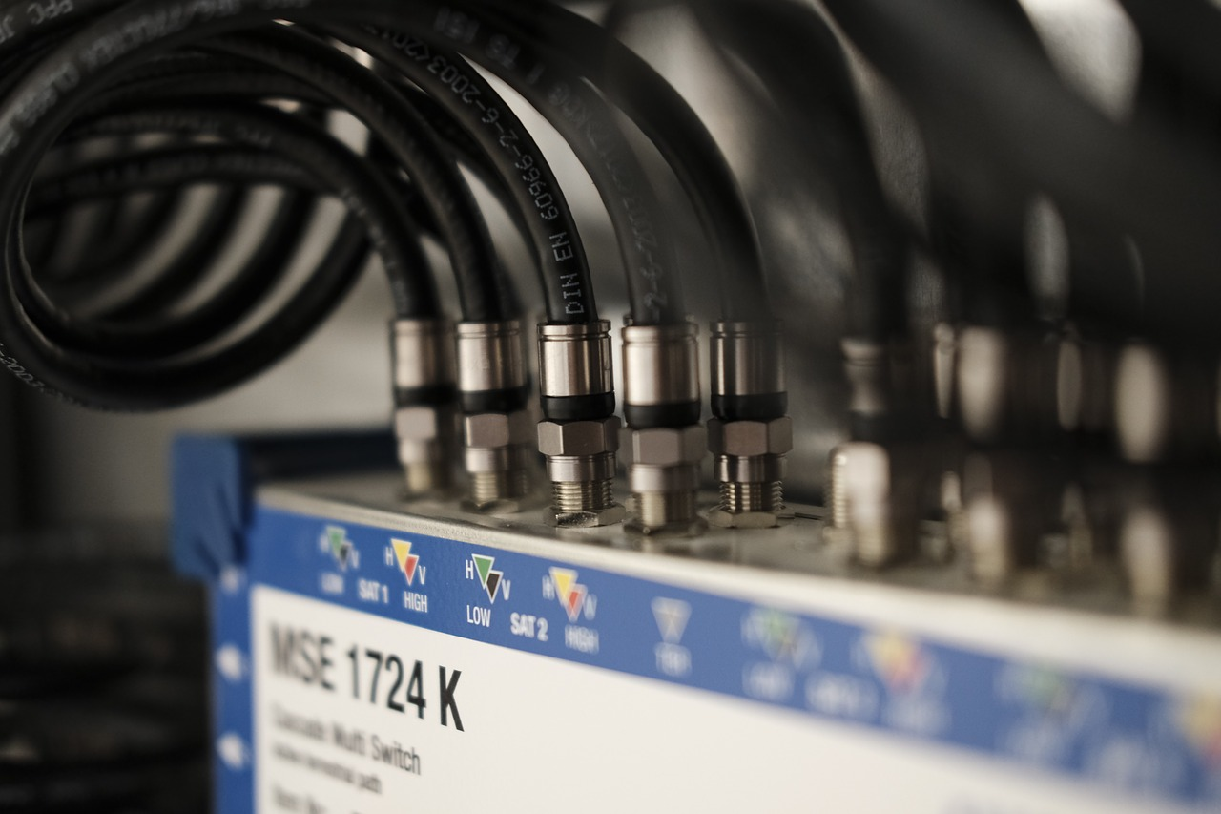
Continuous massive flows than you cannot stop
Image by Bruno /Germany from Pixabay
e.g., social media, telcos’ and utilities’ monitoring

Slide 10


Image by Dieter zabel from Pixabay
e.g., physical or cyber alarms
Continuous numerous flows that can turn into a torrent

Slide 13


2nd premises: time (models) matters!

Slide 14
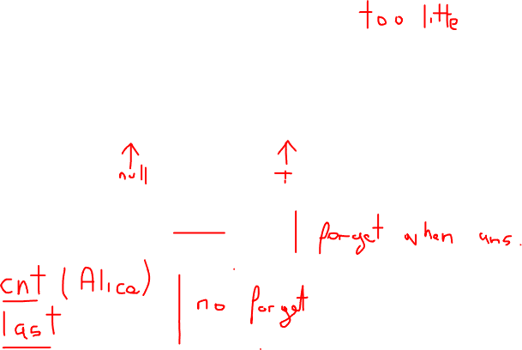
Stream-only Time Model
isWith(Alice,Bob)
isWith(Bob,Diana)
The order can be exploited to perform queries
Does Alice meet Bob before Carl?
Who does Carl meet first?
isWith(Alice,Carl)
isWith(Daina,Carl)
S
e1
e2
e3
e4

Slide 15
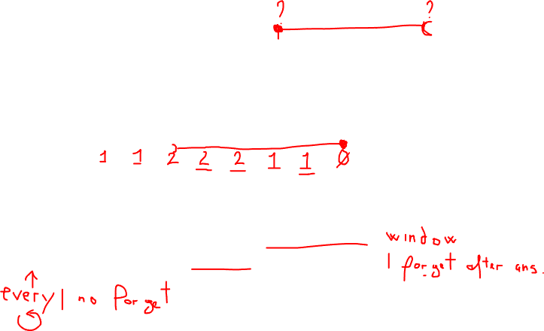
Absolute Time Model
isWith(Alice,Bob)
isWith(Bob,Diana)
We can ask the queries in the previous slide
We can start to compose queries taking into account the time
How many people has Alice met in the last 5m?
Does Diana meet Bob and then Carl within 5m?
isWith(Alice,Carl)
isWith(Daina,Carl)
S
e1
e2
e3
e4
1
3
6
9
t

Slide 16
Interval-base Time Model
isWith(Alice,Bob)
isWith(Bob,Diana)
We can ask the queries in the previous two slides
It is possible to write even more complex queries:
Which are the meetings the last less than 5m?
Which are the meetings with conflicts?
isWith(Alice,Carl)
isWith(Daina,Carl)
S
e₂
e₄
e₁
e₃
1
3
6
9
t

Slide 17
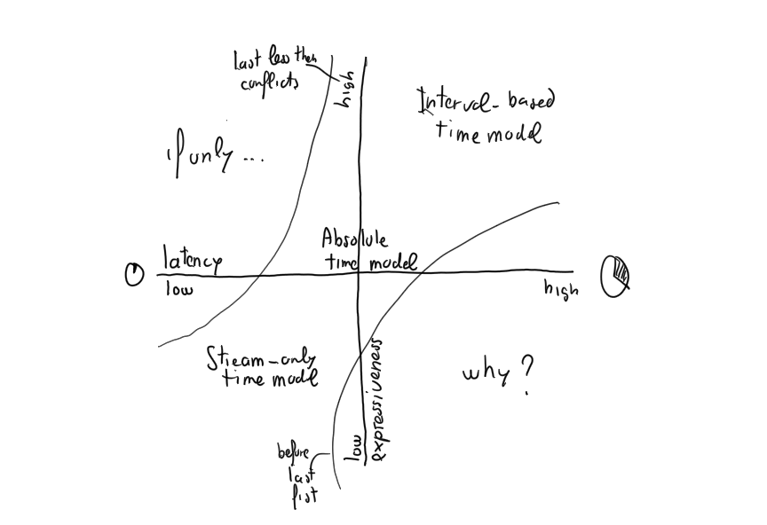
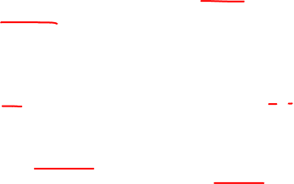
A first trade-off: latency vs. expressiveness

Slide 18
Can we tame data velocity?

Slide 19
Taming
Myriads of tiny flows that you can collect with Event-based Systems
Image by Pexels from Pixabay

Slide 20
On Events and decoupling
Events
an immutable and append-only stream of “business facts”
Decoupling
means decentralizing the freedom to act, adapt, and change

Slide 21
Event-based systems
Events as “first-class” entities
Services emit and consume events asynchronously
Better decoupling with respect to APIs (no temporal coupling)
Eugster, P. T., Felber, P. A., Guerraoui, R., & Kermarrec, A. M. (2003). The many faces of publish/subscribe. ACM computing surveys (CSUR), 35(2), 114-131.

Slide 22

Publish/subscribe
topic=* & place=1st floor
topic=fire* & place=*
Components
collaborate by exchanging events
publish events they observe
subscribe to the events they are interested in
Communication is:
Purely message based
Asynchronous
Multicast
Implicit
Anonymous
fire alarm at 1st floor
fire alarm at 1st floor
fire training at 1st floor
fire training at 1st floor
fire training at 1st floor
topic=fire alarm & place=*
fire alarm at 1st floor
fire alarm at 1st floor

Slide 23
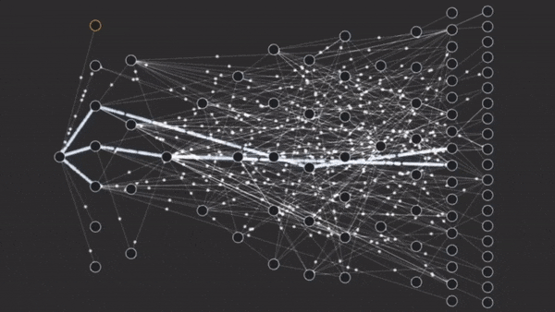
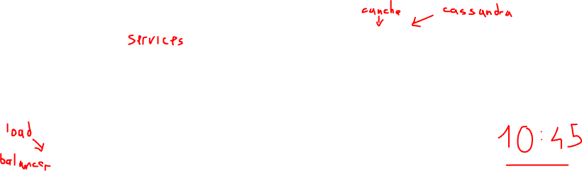
Event-driven architecture @ Netflix
[src. https://labs.sogeti.com/microservices-architectures-stay/ ]

Slide 24
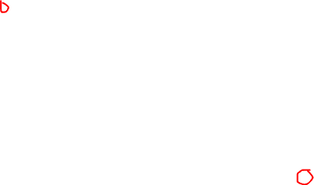
Taming
Continuous massive flows than you cannot stop with Data Stream Mng. Systems

Slide 25

Data Stream Management Systems (DSMS)
Data streams are (unbounded) sequences of time-varying data elements
Represent:
an (almost) “continuous” flow of information
with the recent information being more relevant as it describes the current state of a dynamic system
time

Slide 26
Data Stream Management Systems (DSMS)
The nature of streams requires a paradigmatic change*
from persistent data
one time semantics
to transient data
continuous semantics
* This paradigmatic change first arose in DB community in the late '90s

Slide 27

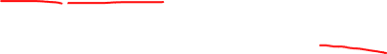
Continuous Semantics
Continuous queries registered over streams that are observed trough windows
window
Dynamic System
Registered Continuous Query
input streams
streams of answer
E. Della Valle

Slide 28
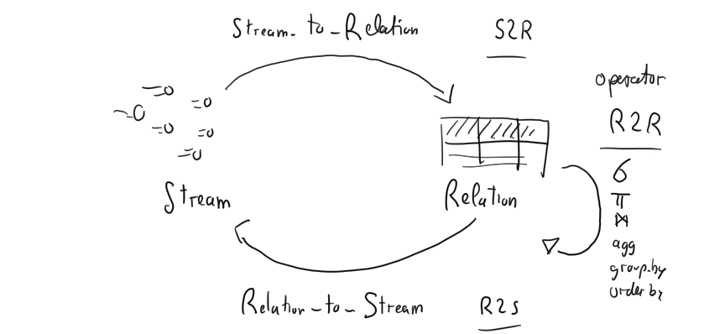
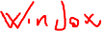
DSMS Semantics
Arasu, A., Babu, S. and Widom, J., 2006. The CQL continuous query language: semantic foundations and query execution. The VLDB Journal, 15(2), pp.121-142.

Slide 29

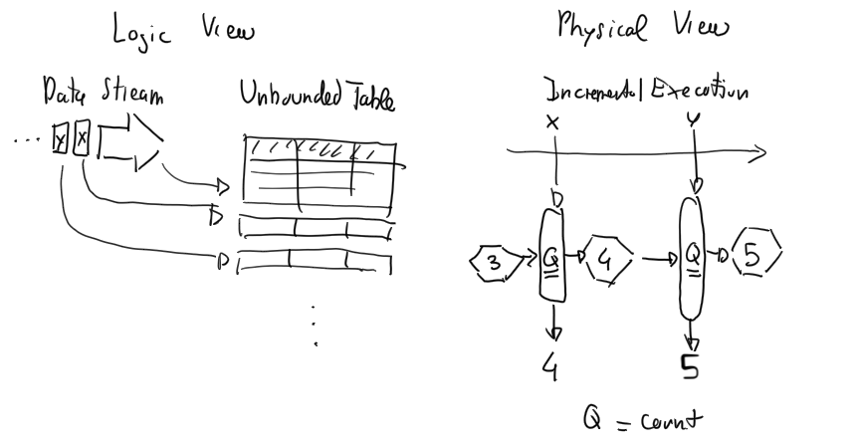
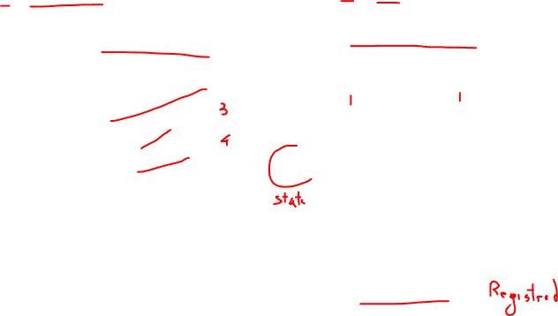
Modern DSMS

Slide 30

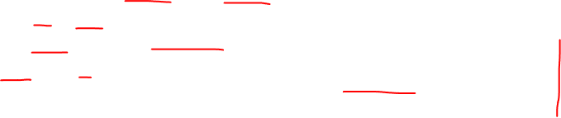
SQL Extensions
Windowed aggregation
SELECT x, COUNT(*), SUM(y)
FROM s1 WINDOW TUMBLING (SIZE 1 MINUTE)
GROUP BY x
EMIT CHANGES;
Join two streams together
CREATE STREAM s3 AS
SELECT s1.c1, s2.c2
FROM s1 JOIN s2
WITHIN 5 MINUTES
ON s1.c1 = s2.c1
EMIT CHANGES;

Slide 31
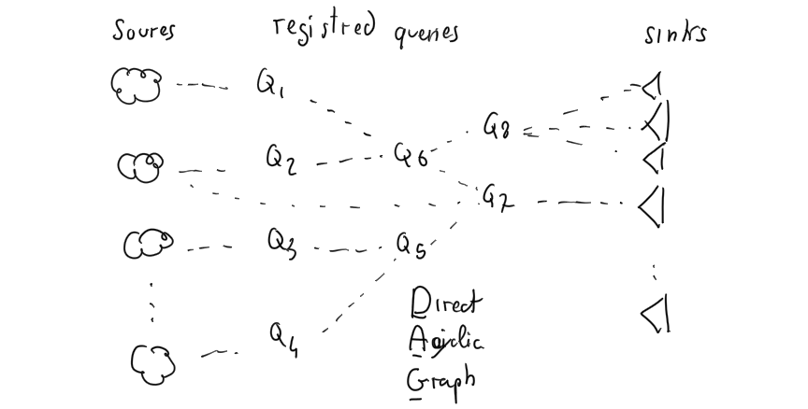
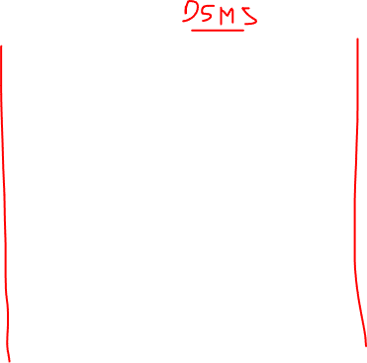
Typically queries are placed in a network

Slide 32
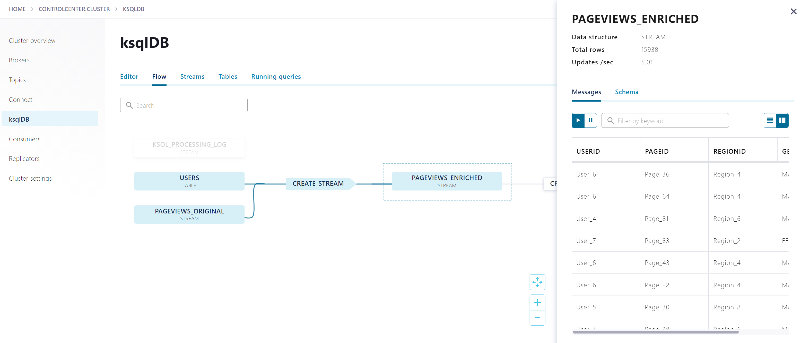
Typically queries are placed in a network
[src: https://docs.confluent.io/platform/current/control-center/ksql.html ]

Slide 33
Taming
Continuous numerous flows that can turn into a torrent with Complex Event Processing

Slide 34
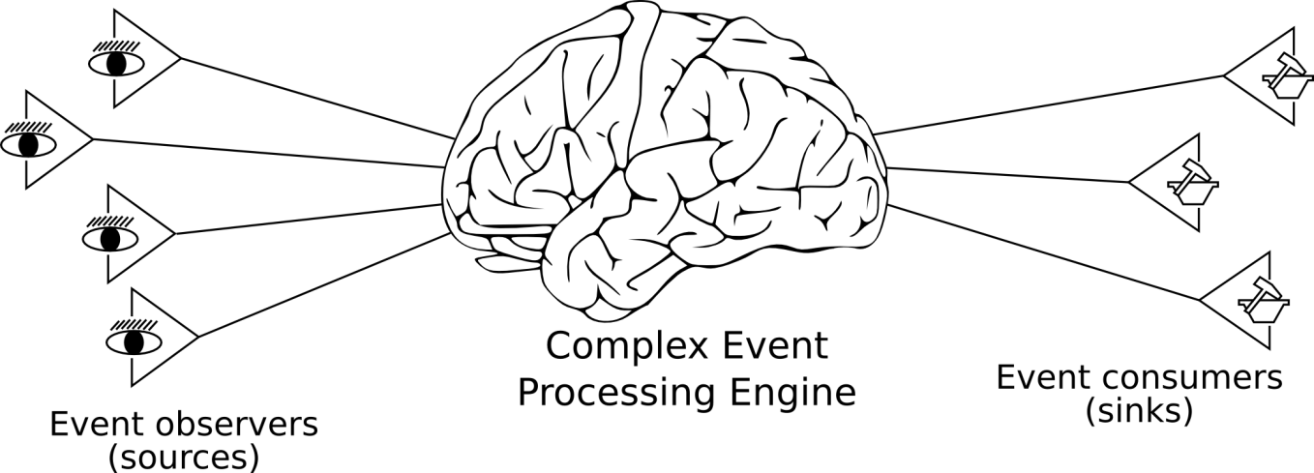
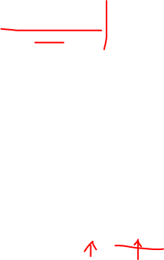
Complex Event Processing (CEP)
CEP systems adds the ability to deploy rules that describe how composite events can be generated from primitive (or composite) ones
Typical CEP rules search for sequences of events
Raise C if A→B
Time is a key aspect in CEP
-----
-----
-----
-----
Rules
Cugola, G., & Margara, A. (2012). Processing flows of information: From data stream to complex event processing. ACM Computing Surveys (CSUR), 44(3), 1-62.

Slide 35
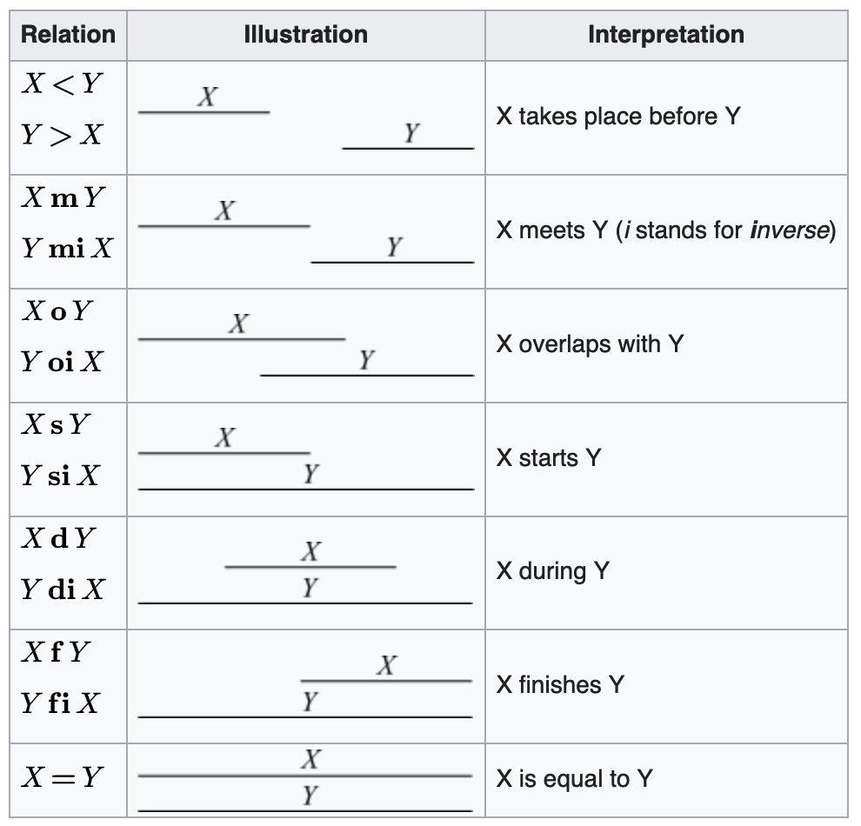
CEP semantics
subsets of Allen’s Interval Algebra
[src: https://en.wikipedia.org/wiki/Allen%27s_interval_algebra ]

Slide 36

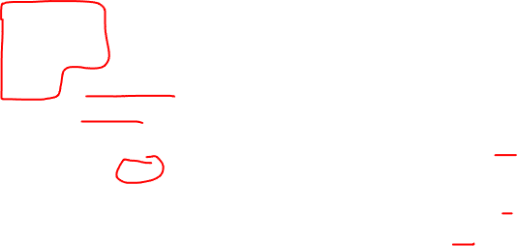
Detecting Languages
Write a query which alerts on each IBM stock tick with a price greater then 100 followed by an IBM stock tick lower than 100 within 60 seconds
Event Processing Language (EPL)
insert into alertIBM
select *
from pattern [
every (
StockTick(name="IBM",price>100)
->
(StockTick(name="IBM",price<100)
where timer:within(60 seconds))
];
Supported since 2006 Esper by EsperTech Inc. and Oracle CEP

Slide 37
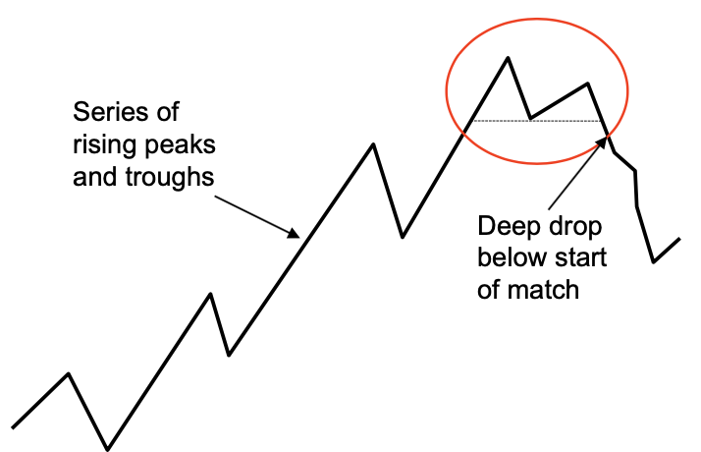

More Expressive Detecting Languages

Slide 38
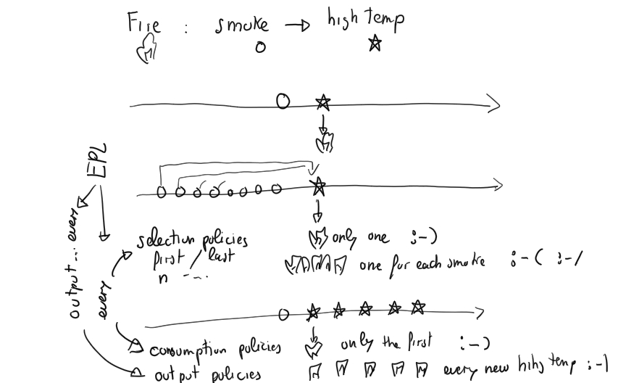
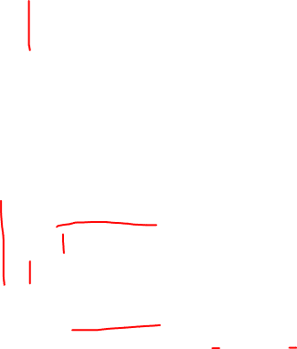
Why can event-based systems fight the torrent effect?

Slide 39
Wrapping up

Slide 40
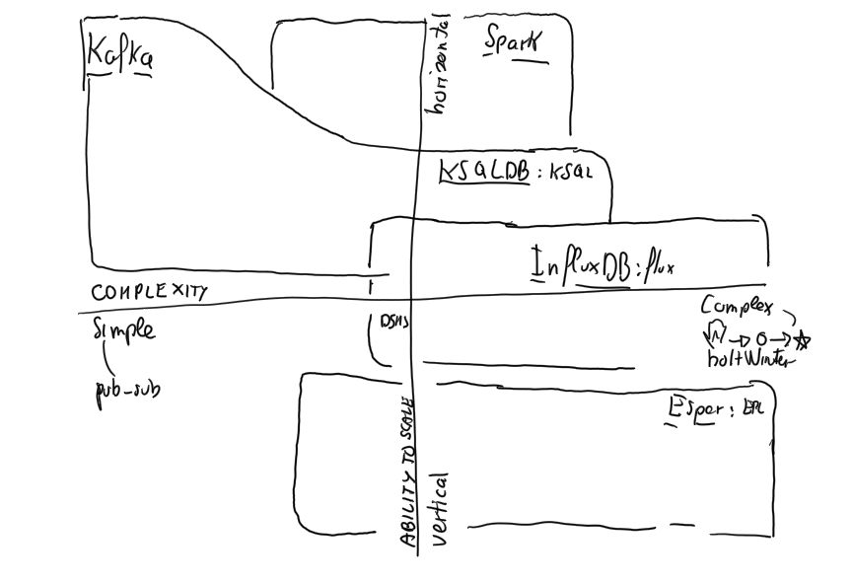
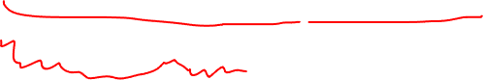
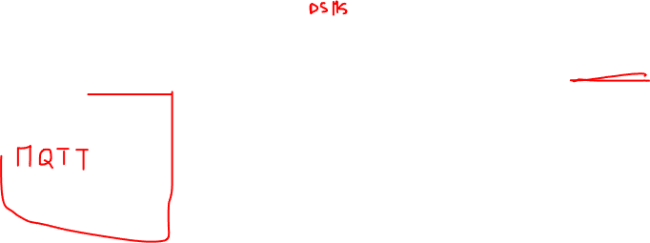

Slide 41
Thank you for your attention! Questions?

Slide 42
Credits
These slides are partially based on
"A modeling framework for DSMS and CEP" by G. Cugola and A. Margara presented in the PhD course on "Stream and complex event processing" offered by Politecnico di Milano in 2015.
http://www.streamreasoning.org/courses/scep2015
"Tutorial: Stream Processing Languages" by Martin Hirzel, IBM Research AI. 1 November 2017 Dagstuhl Seminar on Big Stream Processing Systems
https://materials.dagstuhl.de/files/17/17441/17441.MartinHirzel1.Slides.pdf
"The Death and Rebirth of the Event Driven Architecture" by Jay Kreps, Confluent, Kafka Summit 2018
https://www.confluent.io/kafka-summit-london18/keynote-the-death-and-rebirth-of-the-event-driven-architecture
“Time Series Databases” by Dmitry Namiot
https://www.slideshare.net/coldbeans/on-timeseries-databases
“Fractal Tree Indexes : From Theory to Practice” by Tim Callaghan
https://www.slideshare.net/tmcallaghan/20131112-plukfractaltreestheorytopractice

Slide 43
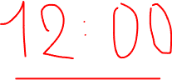
Streaming Data Engineering A Tale of Three Streams
Emanuele Della Valle
prof @ Politecnico di Milano
founder @ Quantia Consulting
Founder & CRO @ motus ml

